Slide 1
EDA RETAIL STORE ANALYSIS
Analysed using python (pandas, numpy, seaborn, matplotlib)
by Eryk Suchan
Data Source:
https://www.kaggle.com/datasets/mohammadtalib786/retail-sales-dataset

Slide 2
OUTLINE
Introduction
Data Sources
Documentation of cleaning and manipulation
Summary of Data Analysis
Key Visualisations and Findings
Summary

Slide 3
Introduction
My name is Eryk and I am responsible for creating the following EDA Retail Store Analysis. This Analysis was created in order for me to practice more real life projects that can come across my journey. My biggest learning factor in this analysis was not to forget about data manipulation and cleaning. One particular point mentioned later on will explain what I mean.
The chosen dataset for this analysis is ‘Retail Sales Analysis’. The main focus in this project was to find out the key data from each column. This sort of data is easy to manipulate, work with and analyse. On the way, there were some challenges, for instance with extracting the months from the years but I have managed to gather all of the data that I wanted.
Personal Task: My main goal is to showcase the retail business the insights of their sales and how can they improve moving forward.
Problem: The data within the csv file isn’t clearly readable for the majority. My job is to implement different graphs to present the data within the table.

Slide 4

Data Source Used
The data source has been used from kaggle via Public Domain. Below is a short project description: This dataset is a snapshot of a fictional retail landscape, capturing essential attributes that drive retail operations and customer interactions. It includes key details such as Transaction ID, Date, Customer ID, Gender, Age, Product Category, Quantity, Price per Unit, and Total Amount. These attributes enable a multifaceted exploration of sales trends, demographic influences, and purchasing behaviors.
This data is deemed credible as it operated under a public domain with data made available.

Slide 5

Documentation of cleaning and manipulation

Slide 6
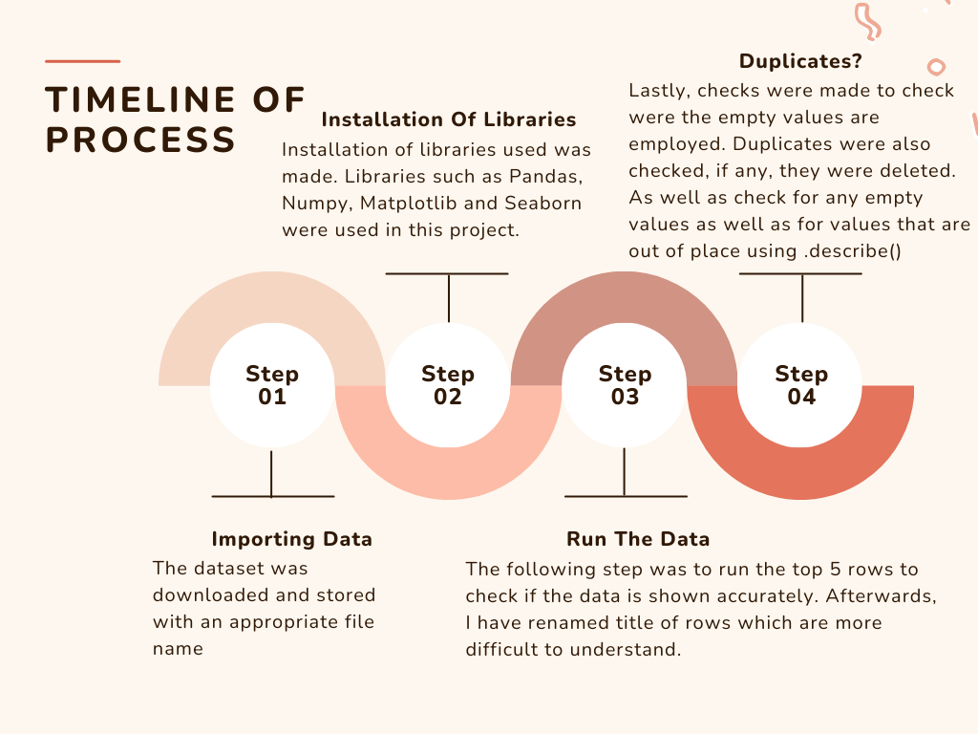

Slide 7
Summary Continued
Summary analysis was carried out on the dataset and the following statistics were taken:
A table proving that no values were out of range
A box plot showing the age distribution by gender
Age distribution by Product Category - what the average age was for each product
Quantity distribution by Sales Amount - boxplot
Pie chart showcasing the age percentage
Bar chart with Men, Women and Total Amount (units)
Product category split into percentage in a pie chart
Total Amount of product category
Line plot showing buying age vs product category
Triple bar graph showing the top 3 ages with the most sales
Line plot showing the sales made per month ( 6 months)
Monthly sales from beginning of 2023 to the start of 2024.
May 2023 Sales were at the top so I create a bar graph showing which category had most sales
Average quality amount bought in each product category

Slide 8

Key Findings

Slide 9
Key Findings:
As I was cleaning the data, I have found out that there were no missing values and no values that had any strange outstanding amount.
When it comes to age, younger females spend more money at the store.
Clothing and Beauty category have the same highest age group.
When a customer bought 2 products, they spend more money than a customer who bought 3 products.
By 2%, there is more females recorded. This is 20 females more in this dataset.
The most sold category was Clothing, standing at 35.1% and beauty with the least with 30.7%.
Age 33 has the highest tendencies to buy most products - beauty and electronics the most.
Top 3 ages who spend the most amount of money were 34,43,51.
In May 2023, people spend most money on electronics.
Biggest sales were made in May 2023.
The Beauty products had the biggest average sales with $467.

Slide 10

Key Visualisations
Visuals from the datasets and analysis

Slide 11
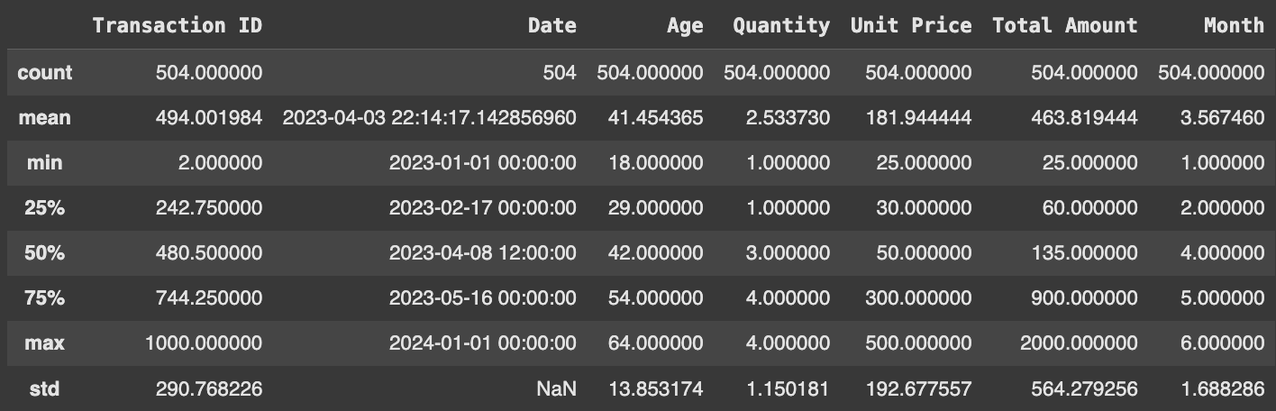
Table 1: Evidence of No Exceeding Values
From the table listed below, we can clearly see a pattern in the values which the data source has provided. There are no clear values that go way below the min and max count. Everything seem to be tidy and in place. Moreover, the null values were also checked and found that there were no missing values in the data, meaning that no major amount of cleaning was done.
One of the things which I did was to rename the column names to make the readability more clear for the end user.

Slide 12
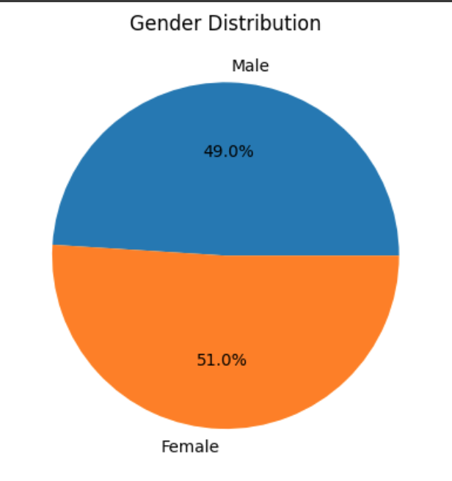
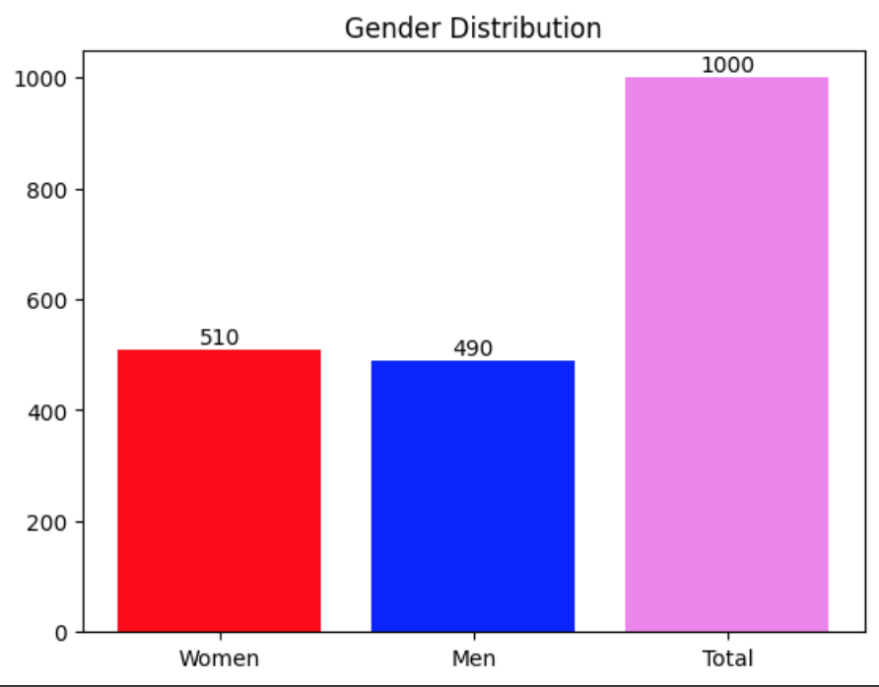
Chart 2 & 3: Gender Distribution
Figure 1
In order for me to start with the research, my first initial thought was to analyse how many males and females were included in the data source. From what we can see in figure 1, the numbers were really close, 49% of the customers were male and 51% of customers were female.
For numeric values, we can see on figure 2 that transforming this into numbers, that 2% comes across to 20 females more. The total amount of customers in the shop was 1000.
Figure 2

Slide 13
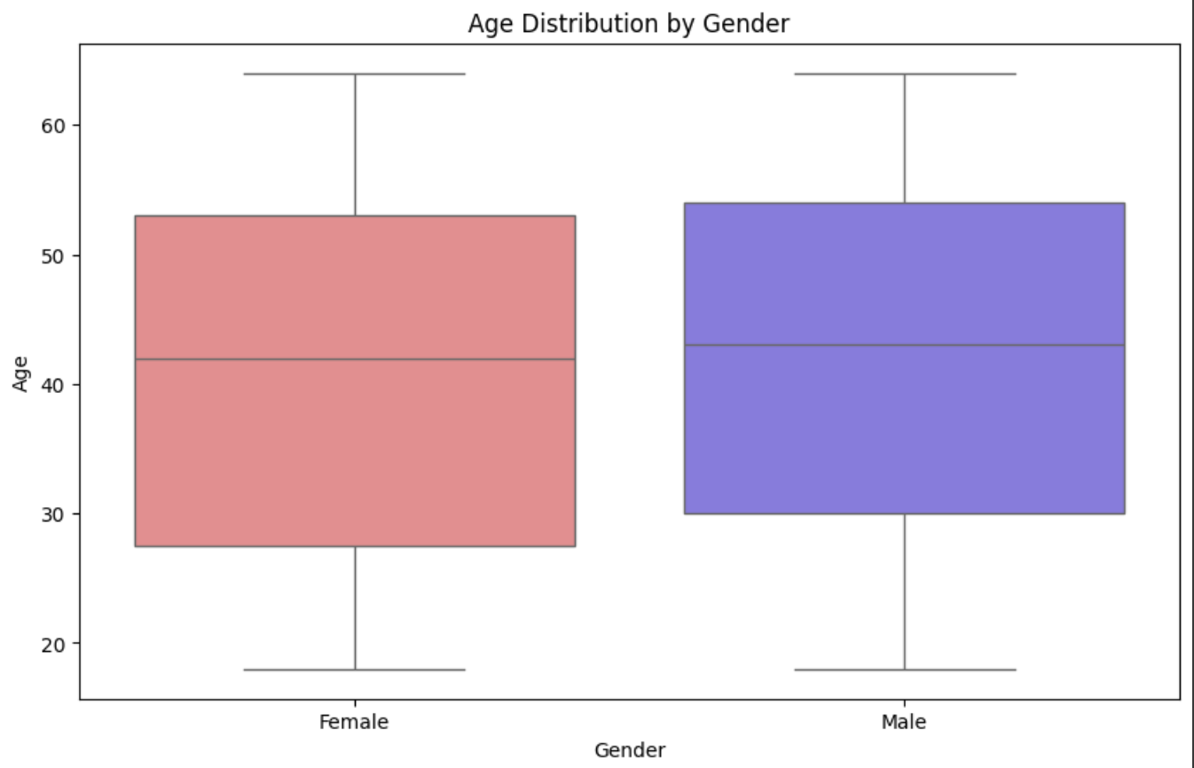
Chart 4: Age Distribution by Gender
From what we can gather from the boxplot on the right, is that there was a wider spread of females that did shopping at this particular shop. The highest age is given to males, whereas the lowest age is given to females. Moreover, the higher average age that does shopping in this shop are the males.

Slide 14
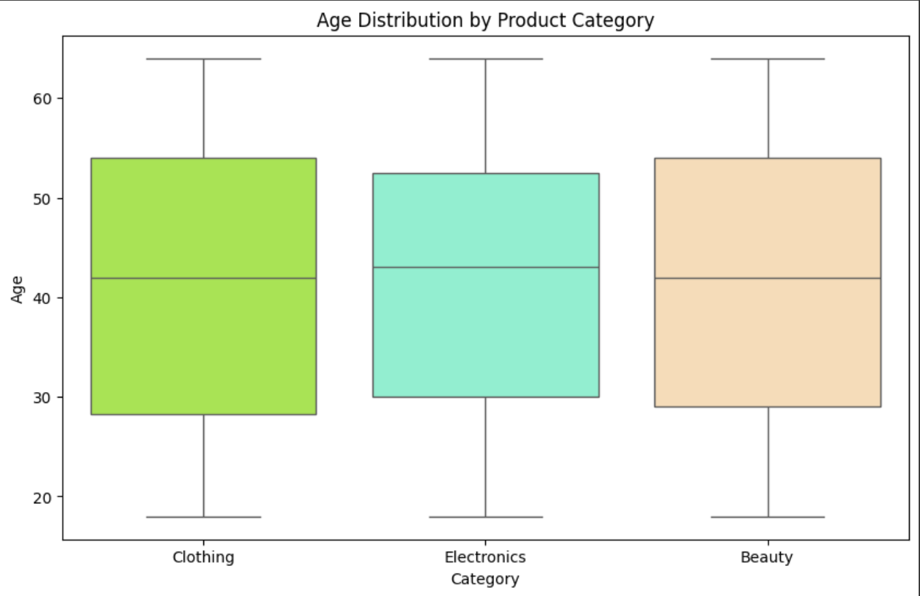
Chart 5: Age Distribution by Category
When it comes to the question ‘ what average age buys what category?’, this boxplot shows this information accurately. We can see that the highest average age is for the electronics category. Whereas the wider spread is for clothing and beauty. This can mean that more people buy electronics in this shop and their average age is higher than the other two categories.

Slide 15
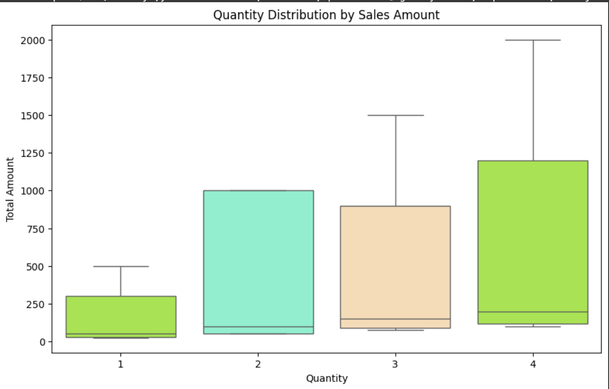
Chart 6: Quantity Distribution by Sales Amount
This boxplot shows us the amount spend for each quantity amount that the customer bought. Not surprisingly, the most money has been spend when the customer bought 4 products in the store and the least has been spend if the customer bought 1 product.
The most surprising part was the total amount spent for 2 products. The pattern shows us that the total amount spent is higher by around $150 than for the quantity of 3 products.

Slide 16
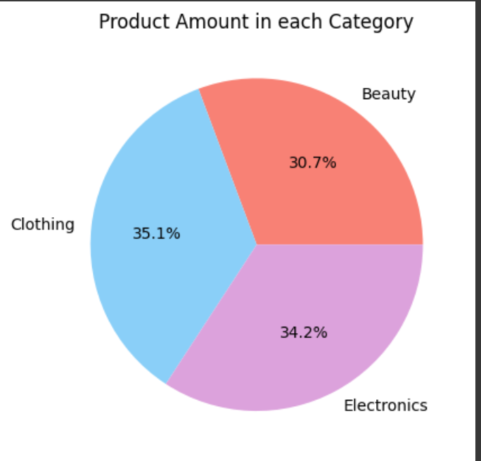
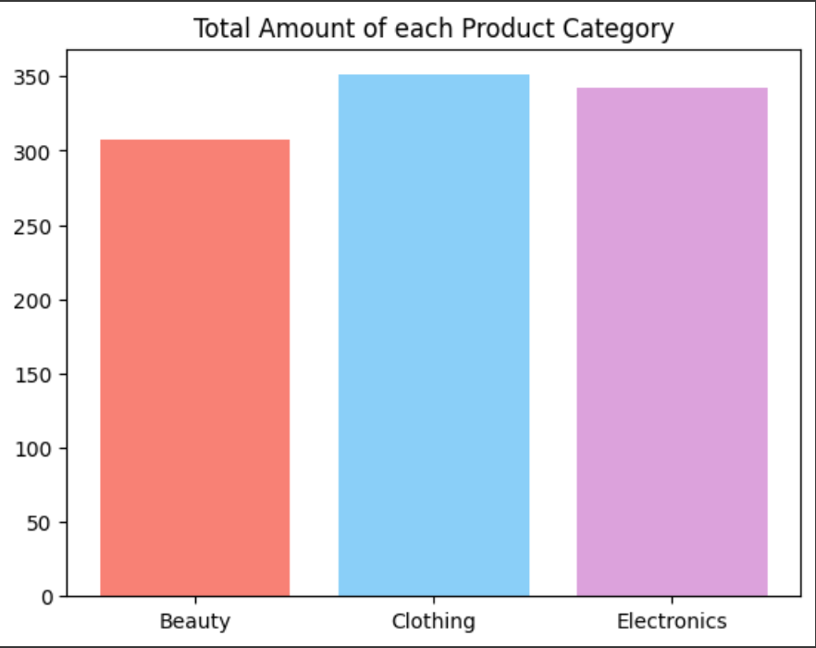
Chart 7 & 8: Total amount sold in each category
Figure 1
The following graphs on the right showcase the amount of products sold in each category. Figure 1 shows us the amount of distribution in percentages, showing clearly that the electronics was sold the most amount of time standing at 34.2%. The beauty products was sold the least with 30.7%.
Figure 2 shows us the same pattern but in amount format. All of the category products stand around the 300/350 mark that was sold.
Figure 2

Slide 17
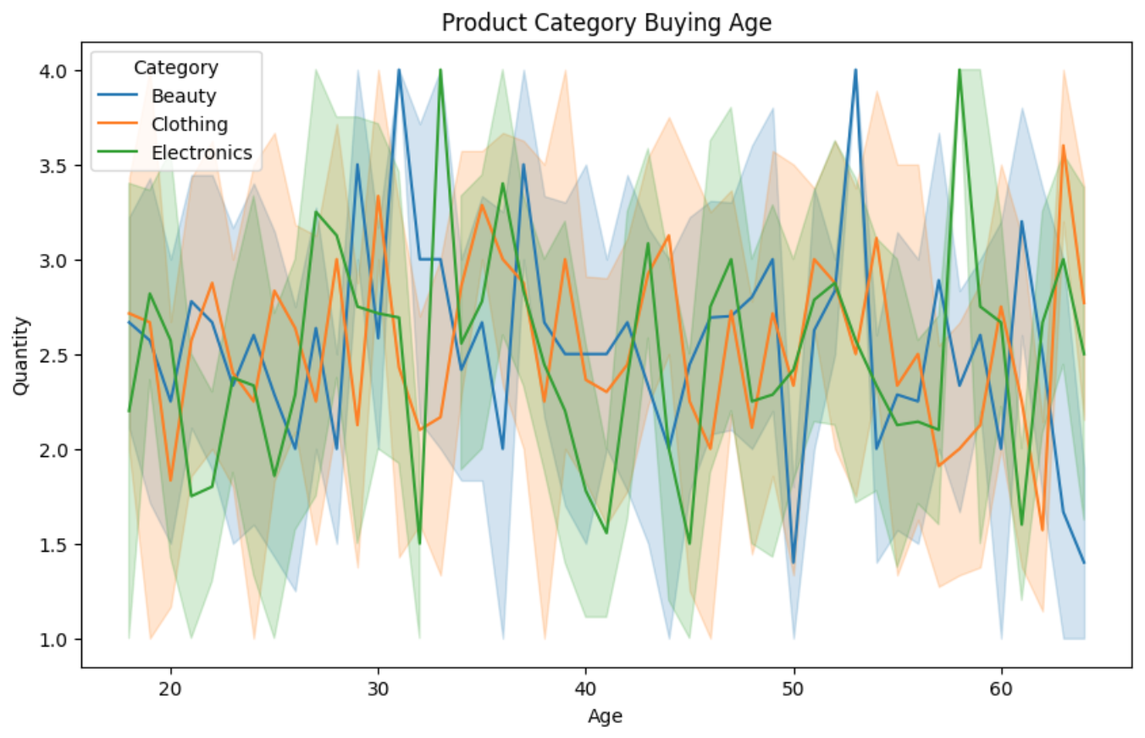
Chart 9: Product Category Buying Age
The line graph on the right shows us the amount quality that each age buys. From the pattern, we can see that the beauty and electronic products are bought most of the time, especially between the age of 30-35 and the pattern is seen again between 50-60. This suggests that the electronic products should be promoted the most in this retail company.

Slide 18
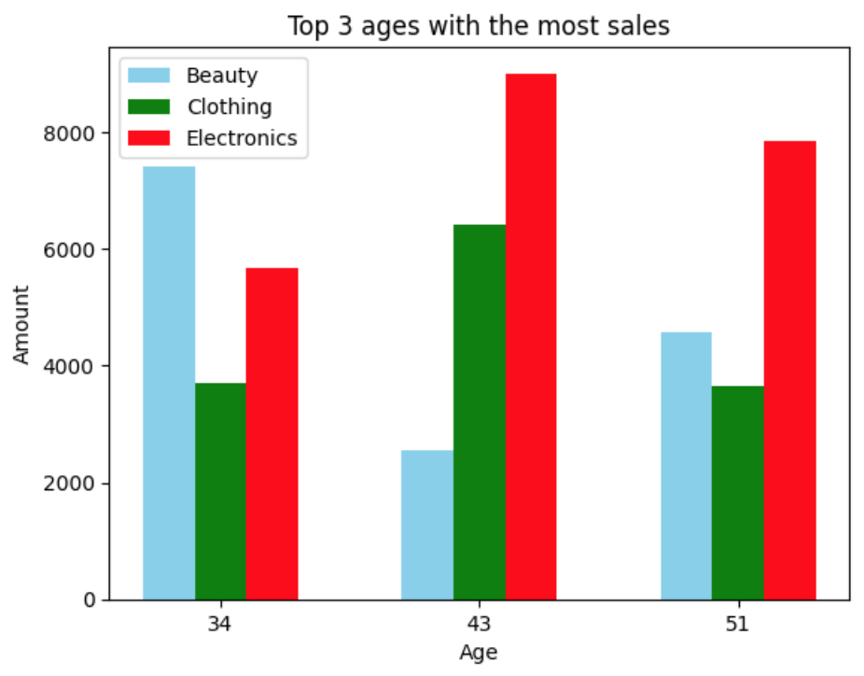
Chart 10: Top 3 ages with the most sales
In order to dive deeper into the sales, I have found out that the top 3 ages that spend the most amount of money in this company are 34,43 and 51. The age 34 clearly shows the higher demand for beauty products whereas the remaining ages show a major demand for the electronics.
This is a a big suggestion for the company, to invest more into selling and distributing electronic products for older ages and beauty products for younger rather than clothing at all.

Slide 19
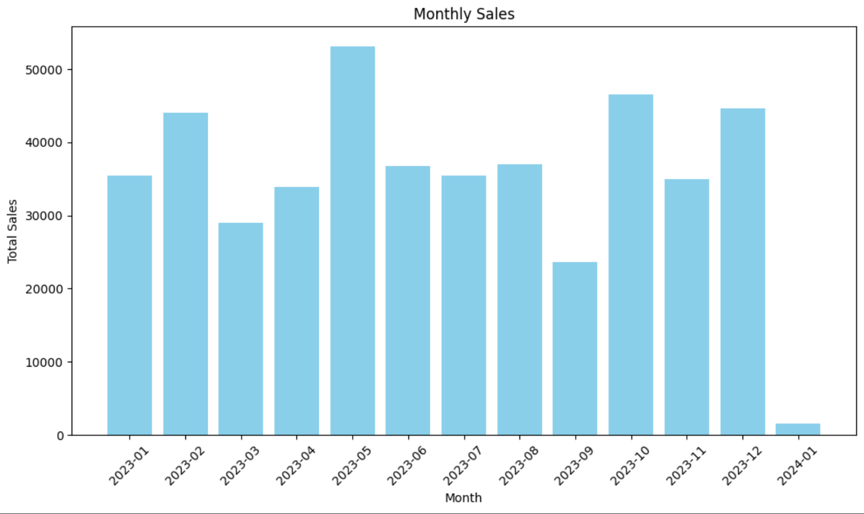
Chart 11: Sales per month across the year
The bar chart on the right shows us a great representation of the total sales in each month. The biggest and most successful month for the company was May of 2023. IT shows that more than $50,000 was made whereas January 2024 shows a significant decrease standing around the $1000 mark.
This can represent that the company has more traffic during the hotter days, especially between May and August.

Slide 20
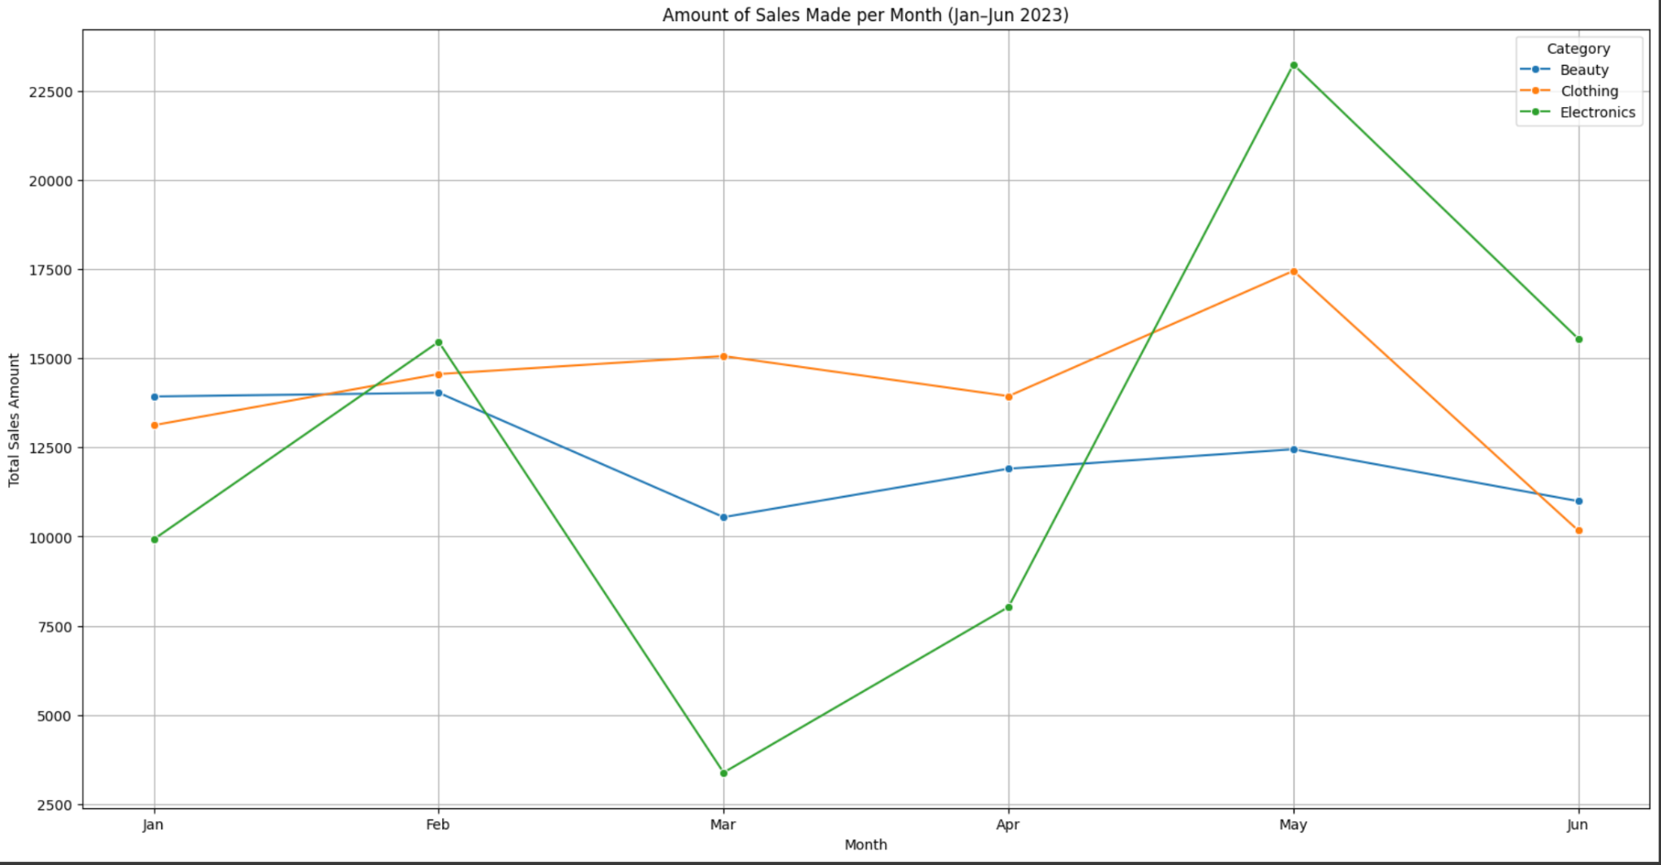
Chart 12: Analysis of sales between January 2023 and June 2023.
As we could see in chart 11, the most sales were made during May of 2023, so in order to dive deeper, I have analysed the first six months of 2023, showing what products sold the most in what month. This chart proves that electronics is the most popular product in the company even in the peak, selling over $22,500 worth of products.
There was although a major dip in March of 2023, showing that any month can drastically change the sales amount of a product.

Slide 21
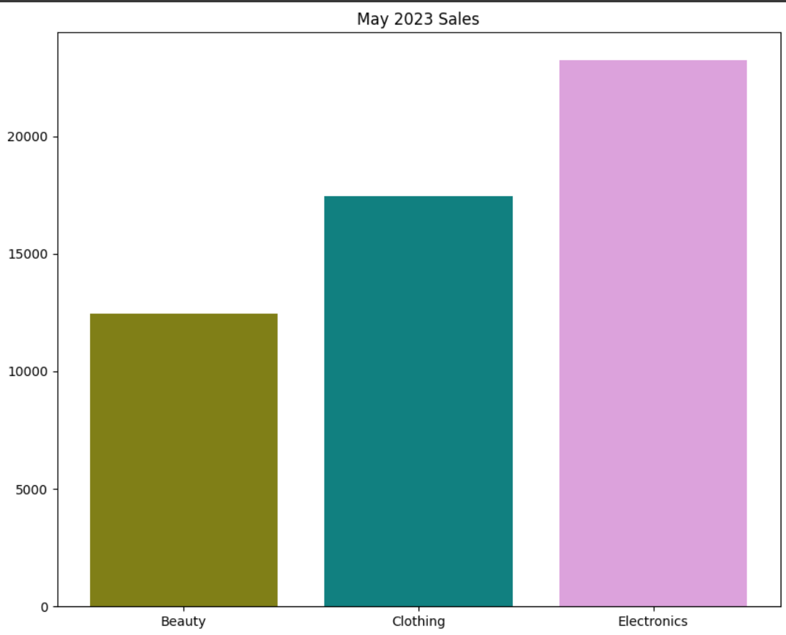
Chart 13: May 2023 Sales
A bar chart was also created to show that the electronics was the main income of the company as of May 2023, nearly doubling the amount of Beauty products sold. The company should definitely focus on the research of their beauty and electronic products, and ask themselves a question. How can we maximise the profits each month of electronics and beauty products even more?

Slide 22
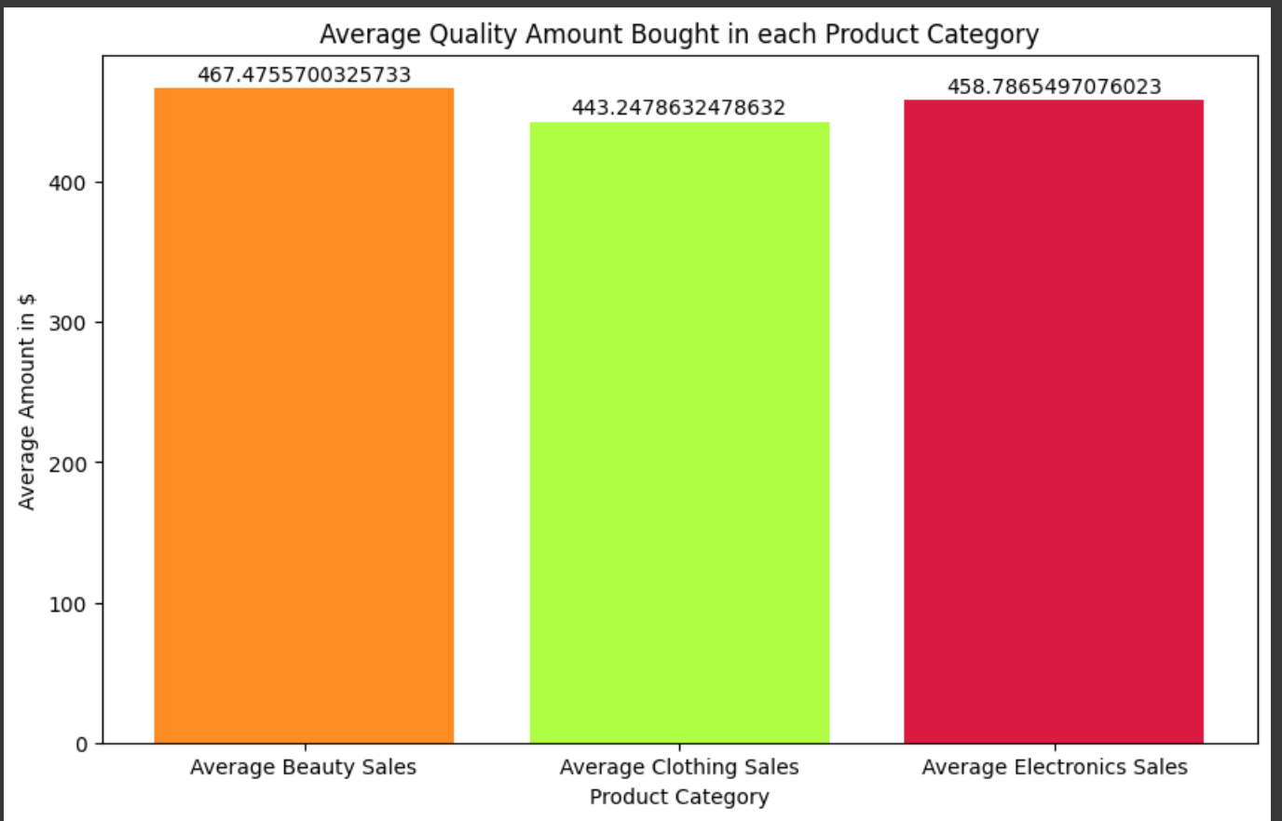
Chart 14: Average amount spent in each product
This bar graphs confirms that the company should focus more on the beauty and electronic products. We can clearly read that both of these product categories have the most success in this retail company.

Slide 23
Summary
This whole EDA research has helped me to understand how crucial data analysis is in companies. From this specific analysis, I have gathered the following suggestions for the company:
Focus on marketing the products togards age groups 30-35 and 50-60.
Make sure to strictly concentrate on the sales of the electronic products. We have seen the biggest success of this category.
As May being the peak season, the company should follow trends in order to marketise their electronic products. Perhaps relate them to summer holidays, how can they be useful during this hotter season?
Clothing products should be abandoned. Focusing on one or two main products will definitely drive the business to wider success.

Slide 24
Thank you!

